Slide 1



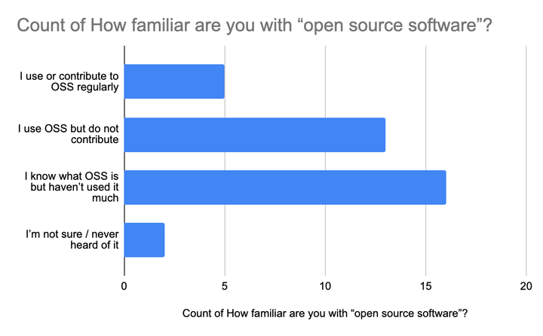
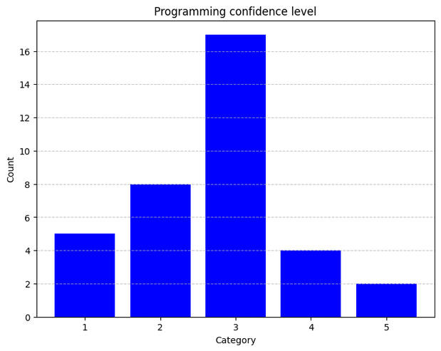
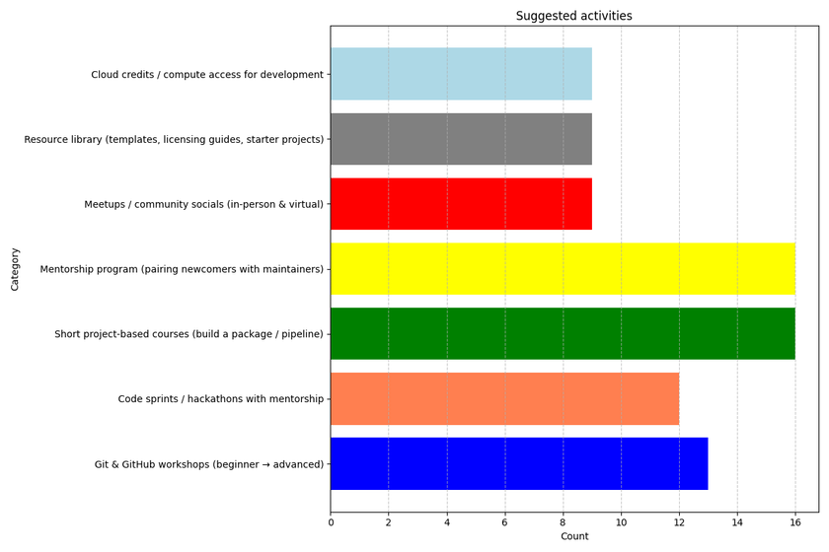

Opening Pathways: Skills, Practice, and Mentorship in Open Source
Introduction
Open source software (OSS) underpins modern bioinformatics and reproducible research
Widely used tools in bioinformatics are primarily open source
OSS participation builds technical skills and research capacity
Limited structured pathways exist for OSS contribution in many training environments
Current levels of awareness and participation in OSS
Technical skills and experience within the community
Barriers preventing individuals from contributing
Types of support and training that would enable participation
Survey Objectives
Our Findings
A lack of awareness
Skilled and interested participants
Several barriers were identified that limit participation
Low confidence
Fear of making mistakes
Uncertainty about where to begin
Difficulty identifying suitable projects
Imposter syndrome
Lack of mentorship
Limited access to supportive communities
Call for Collaboration!
We invite collaborators to:
Co-developing short-term OSS training programs
Supporting hackathons and code sprints
Providing mentorship and technical guidance
Developing pipelines and packages suitable for new contributors
Creating structured onboarding pathways for OSS participation
Collaborate with Us: bioinformaticshubofkenya@gmail.com
Presented by: Pauline Karega
Email: paulinenyakairu.karega@manchester.ac.uk

